Slide 1
The
Blood Diamond
Manifesto
By Alice, Aidan, Jake, Jenson and Rachel

Slide 2
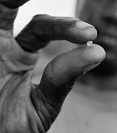
RESEARCH
We as a group have decided to look in the blood diamond conflict and base our collaboration around this issue because out of the five of us one of us knew about this conflict and this sparked interest between us to look deeper into the issue.
Blood diamonds otherwise known as conflict diamonds are part of a set of resources known as conflict resources, these materials are mined in areas that have an on-going conflict such as a civil war. Rebellions force workers to mine resources un paid and sell them to fund their alliance. Many attempts have been made to stop this issues, one of which made it illegal to buy or sell diamonds without proper certification, but this sadly failed and made many companies back out of this programe.
This issue is sadly over looked by many mainstream media sources and is rarely spoken about. Even though it may be new to many people hearing this it has been going on for a very lengthy amount of time.
This issue is mainly focused in central Africa but is happening all over the world.

Slide 3
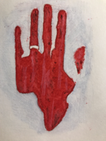
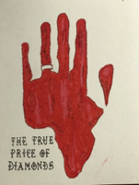
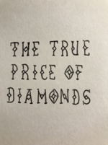
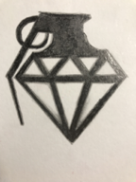
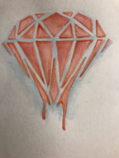
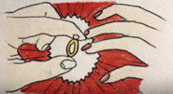
Initial Ideas
My first initial idea was the bleeding diamond; however, I knew that I was not happy just settling for the first design I came up with and so, decided to experiment further.
I then designed the diamond grenade, considering blood diamonds are commonly used to finance the fighting in war zone.
The final initial design I created was the 'engagement' design with the diamond being the focus point, whilst still incorporating a sense of ‘blood’ in the red background, however, I thought that it wouldn’t be powerful enough to get our message across.
Upon reflection, I decided that I wanted to start to merge some of the designs together, I took advantage of the space left on the hand design and incorporated our mantra onto the design, which, with some editing, I think could be a powerful image.

Slide 4
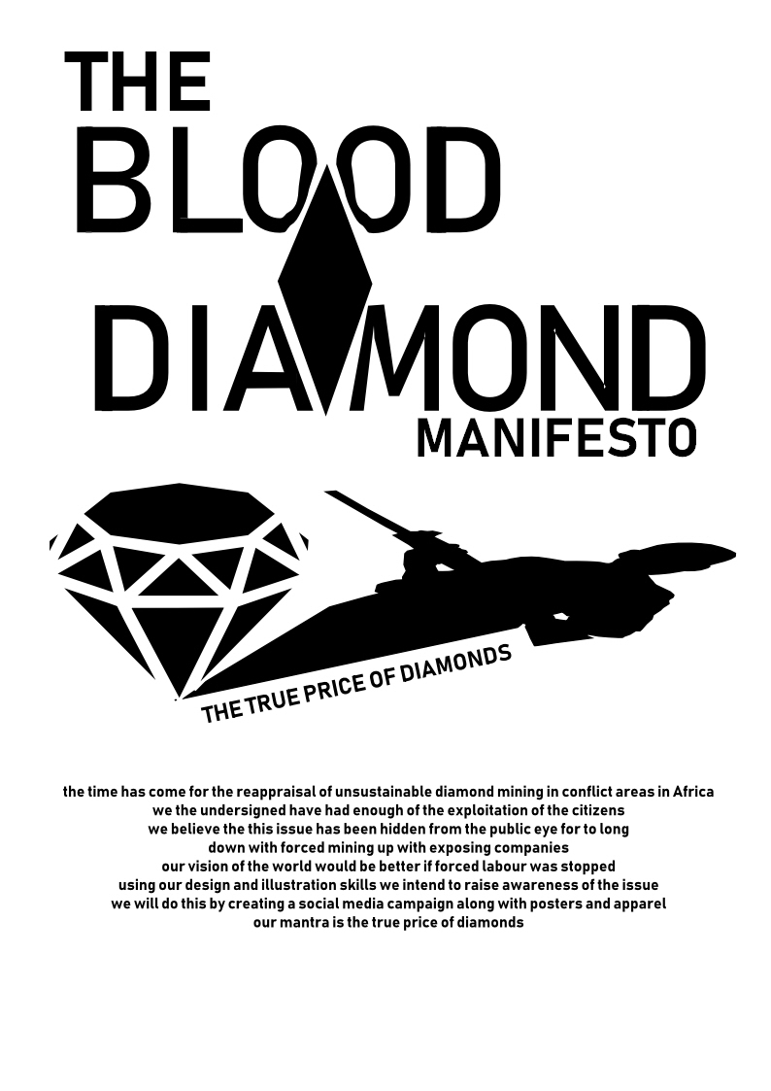
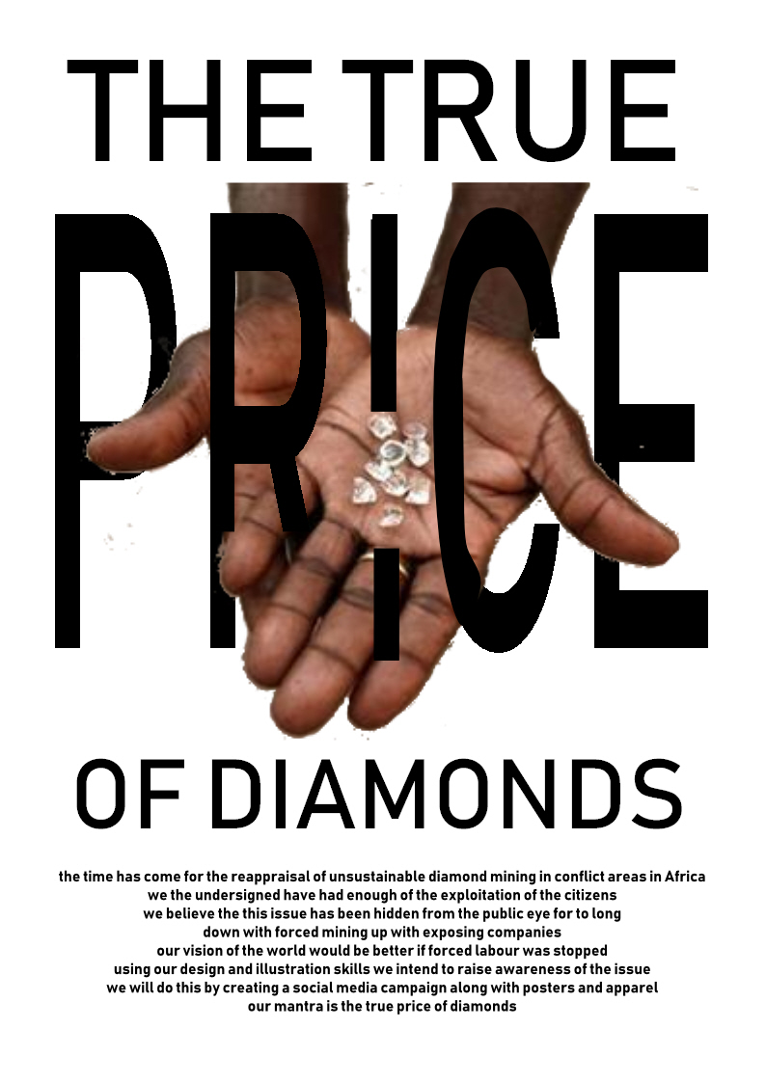
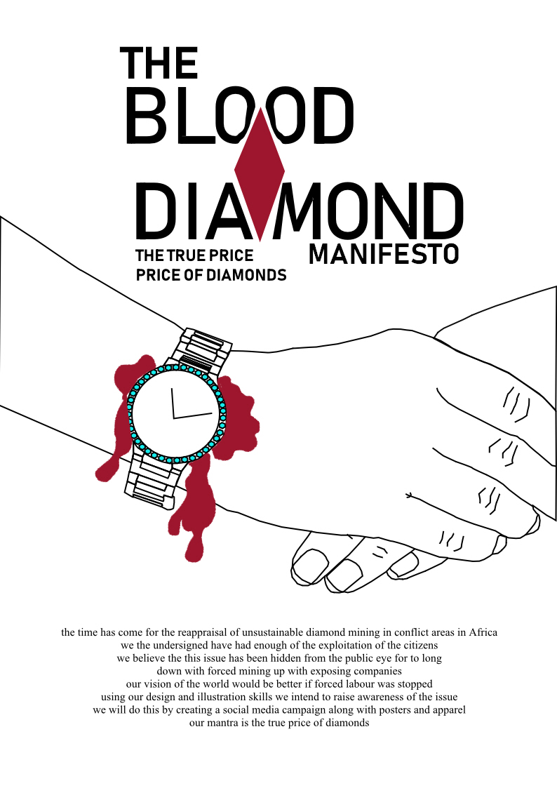
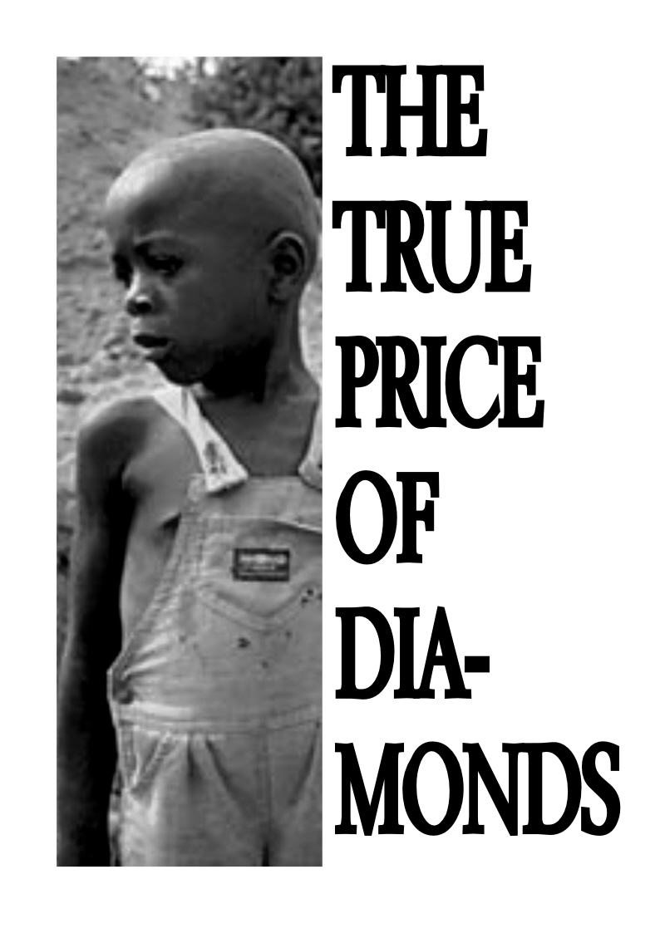
INITIAL IDEAS

Slide 5

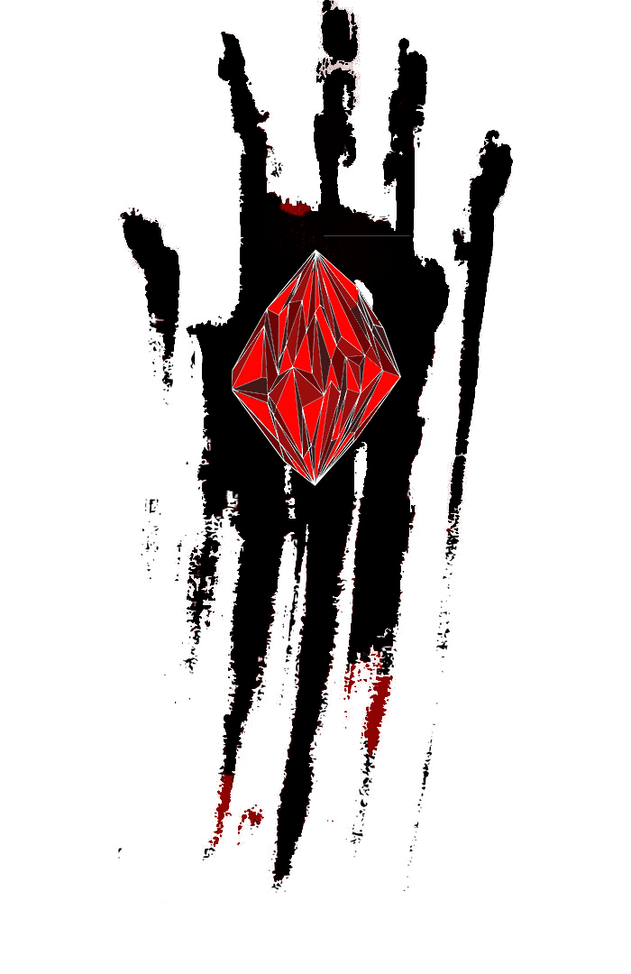
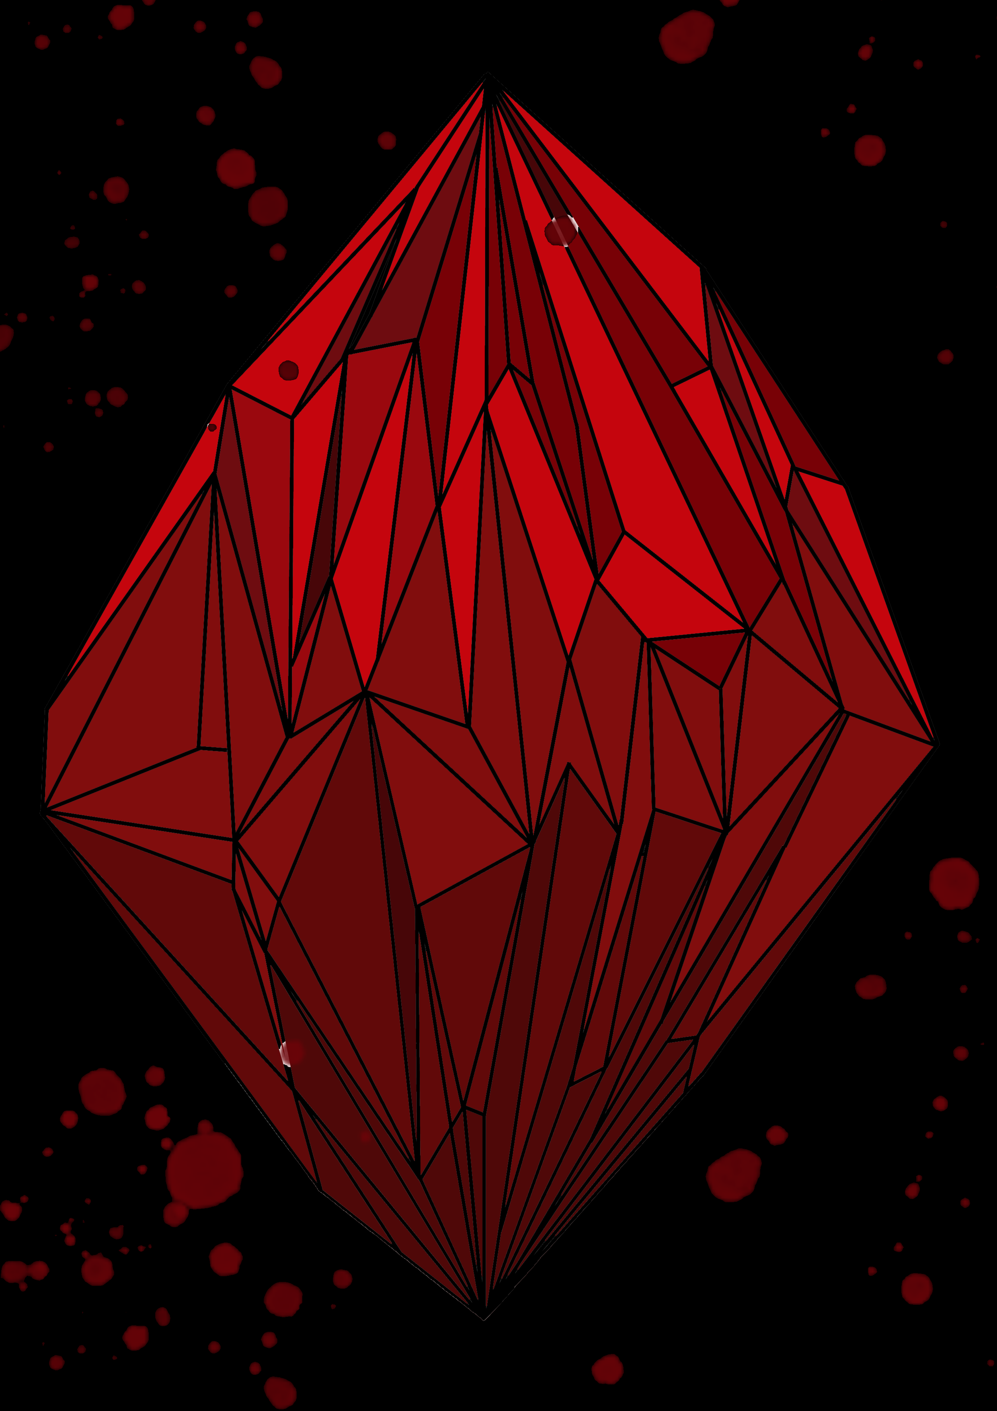
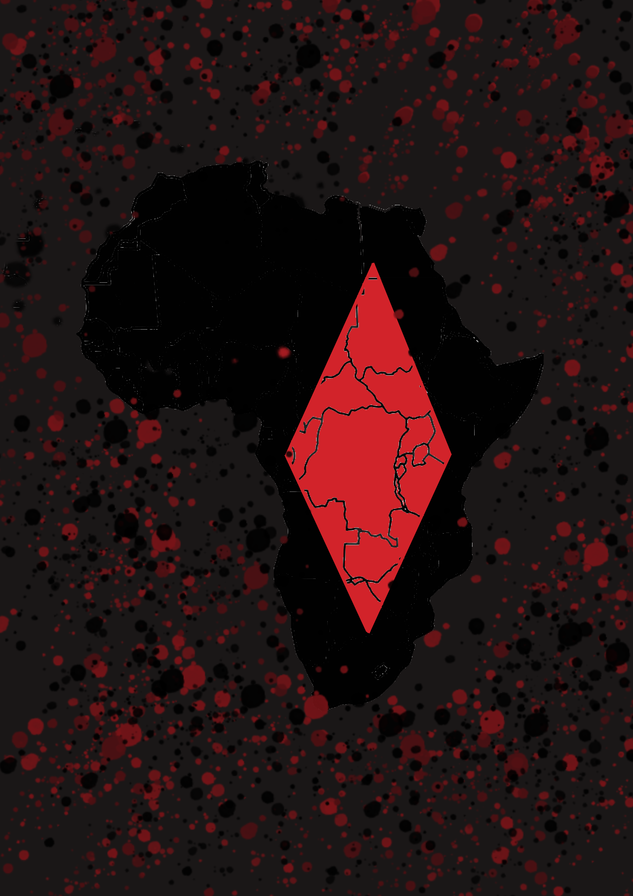
MY INITIAL IDEAS

Slide 6
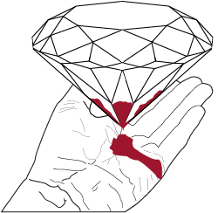
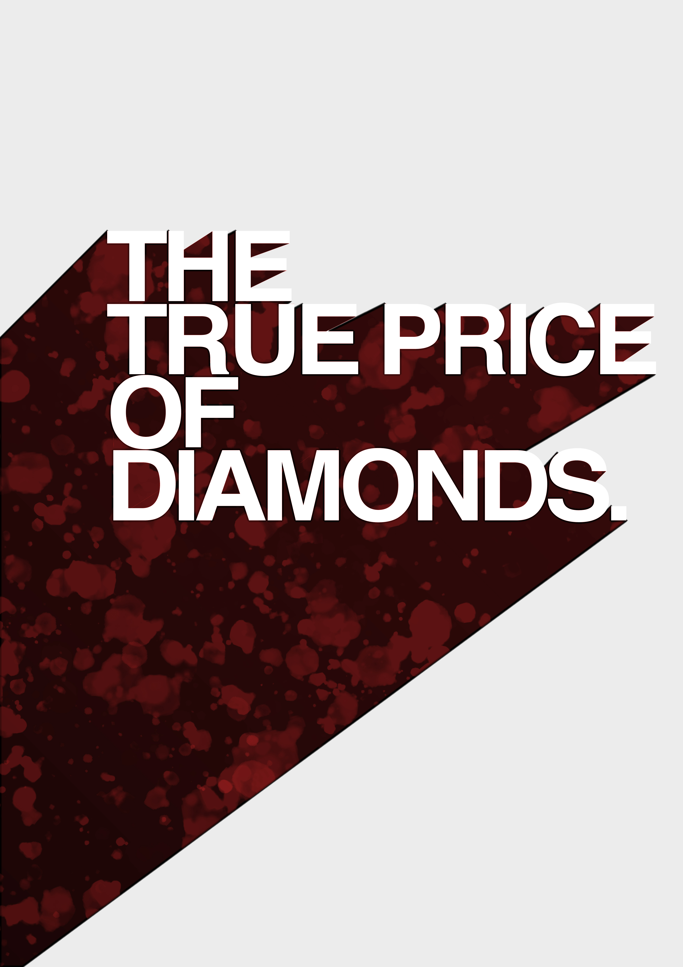
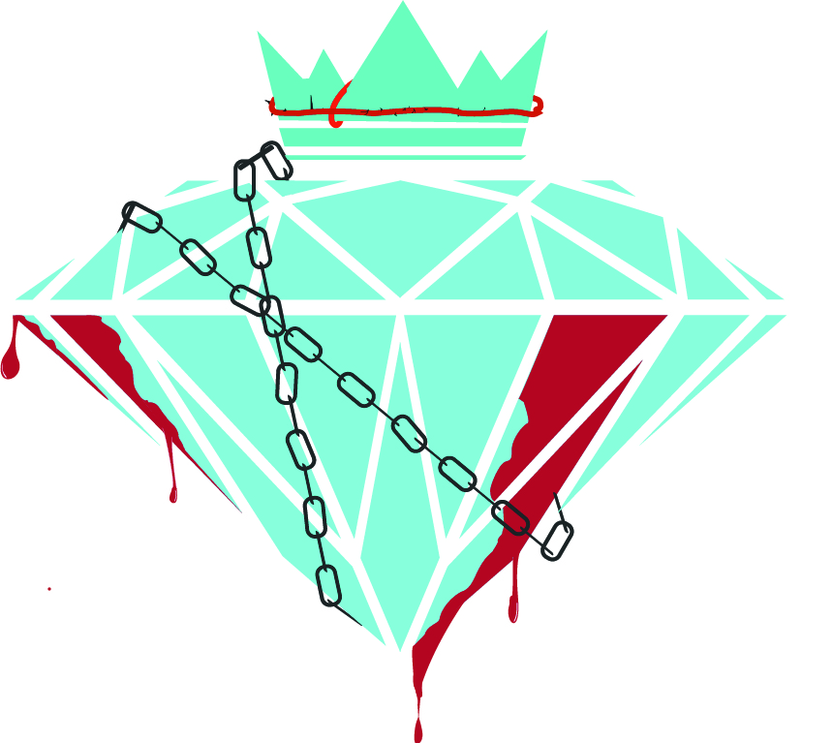
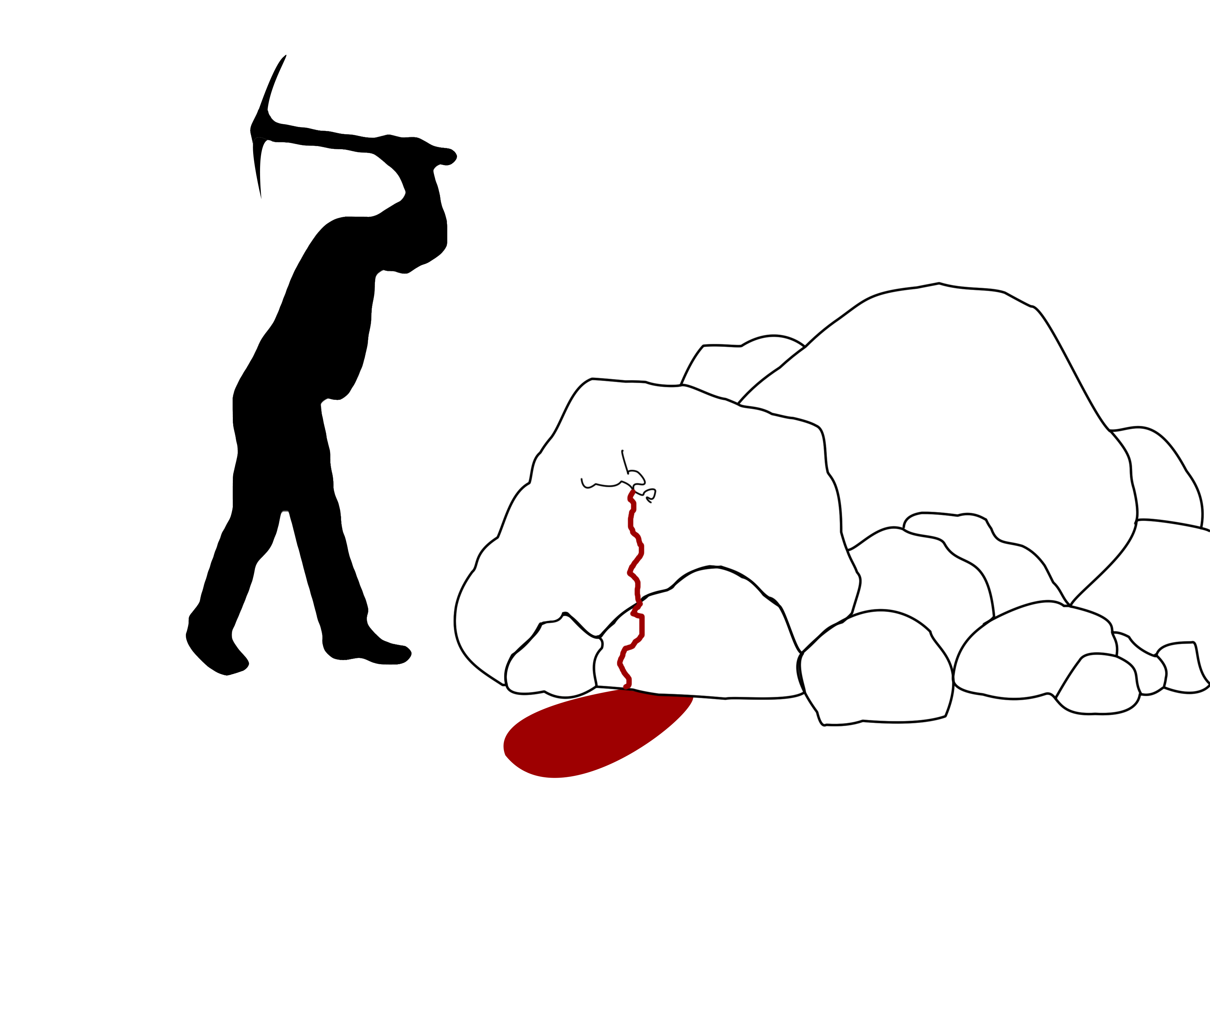

Slide 7
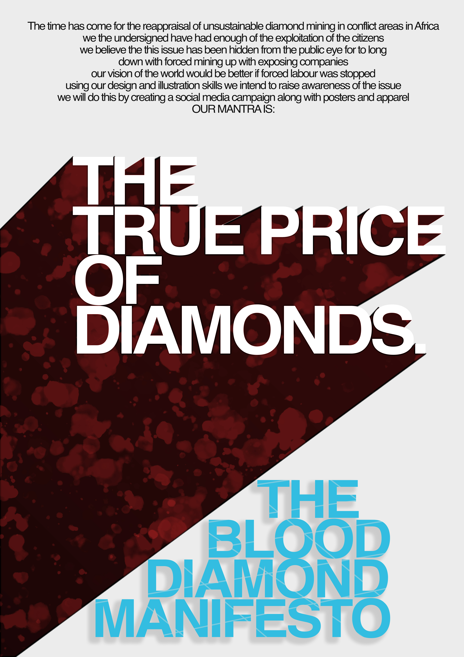
FINAL MANIFESTO

